Slide 1
1
SHOPPING GUIDE
Effective June 1, 2025
Maine
Contact your local WIC agency
for lost or found eWIC cards.
For questions,
please call: 207-287-3991 or wic.maine@maine.gov

Slide 2
What WIC Provides
2
WIC provides free healthy foods and so much more!
WIC offers families who qualify:
Breastfeeding Lactation promotion and support
Benefits to buy healthy foods
Health and social service referrals
Immunization and lead screening and referrals
Tips for eating well to improve health
WIC nutrition staff meet with each WIC participant to:
Review nutrition and health behaviors
Provide individual nutrition advice
Support families making changes for better health
Offer a selection of healthy foods

Slide 3
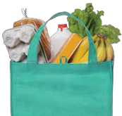
Rights & Responsibilities
3
I have been advised of my rights and responsibilities as a WIC Program participant. I certify that the information I have provided for my eligibility determination is correct, to the best of my knowledge. This certification information is being submitted in connection with the receipt of federal supplemental nutrition assistance. Program officials may verify information I have provided.
I UNDERSTAND I MAY BE DROPPED FROM THE WIC PROGRAM IF:
YOUR RIGHTS:
Your personal information will be kept confidential unless you give written permission to release it, or unless required by law to be shared. Examples of such sharing include:
Providing my information to the United States Department of Agriculture (USDA), which oversees WIC;
Sharing with certain Maine Department of Health and
Human (DHHS) offices that serve WIC participants to determine
my eligibility for those programs and make the application process easier;
Sharing with DHHS programs for the purpose of improving my health, education or well-being if I am already enrolled in their programs;
Contacting the DHHS Office of Child and Family Services (OCFS) if there is a health or safety concern regarding my child or children.
Standards for eligibility for WIC are the same for everyone, regardless of race, color, national origin, age, disability or sex.
If you feel you have been discriminated against, you may file a complaint.
I or my child(ren) participate in more than one WIC Program at a time (dual participation)
I provide false information about income, family size and residence location (fraud)
I or my Alternate Representative / proxy spends eWIC cards at a vendor (store, farm stand or farmers’ market) that is not authorized to accept them (fraud)
I or my Alternate Representative / proxy buys non-WIC foods with eWIC card (trafficking)
I or someone on my behalf sells, trades, or gives away my eWIC card (trafficking)
I or someone on my behalf returns WIC foods for cash, credit or non-WIC foods (trafficking)
I or someone on my behalf sells or trades WIC foods, including infant formula, which was purchased with eWIC card for cash, credit, or other foods or services (trafficking)
I or someone on my behalf gives away WIC foods, including infant formula, which was purchased with eWIC card (fraud)
I or someone on my behalf makes changes to my eWIC card(s) (forgery)
I or someone on my behalf posts WIC items for sale, exchange or free on any media, including social media (such as Facebook), Craigslist, eBay, television, radio, newspaper or other online forum (trafficking)
I or someone on my behalf verbally or physically abuses WIC or grocery store staff (abuse)
YOUR RESPONSIBILITIES:
Bring all documentation requested to each appointment.
Report address and/or phone changes to your local WICoffice.
Keep your eWIC card safe; lost/stolen cards may not be replaceable.
IF I VIOLATE THE PROGRAM RULES ABOVE, I OR MY FAMILY:
May be taken off the program for up to one year
Will have to pay money back to the program for foods or formula I should not have received
May face legal charges

Slide 4
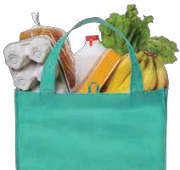
Non-Discrimination Notice
4
NON-DISCRIMINATION NOTICE:
In accordance with Federal and state law and U.S. Department of Agriculture policy, this institution is prohibited from discrimination against certain protected classes. This notice is available in alternate formats, uponrequest.
Maine DHHS Nondiscrimination Notice
The Department of Health and Human Services (“DHHS”) does not discriminate on the basis of disability, race, color, sex, gender, sexual orientation, age, national origin, religious or political belief, ancestry, familial or marital status, genetic information, association, previous assertion of a claim or right, or whistleblower activity, in admission or access to, or the operation of its policies, programs, services, or activities, or in hiring or employment practices. This notice is provided as required by and in accordance with Title II of the Americans with Disabilities Act of 1990 (“ADA”); Title VI of the Civil Rights Act of 1964, as amended; Section 504 of the Rehabilitation Act of 1973, as amended; Age Discrimination Act of 1975; Title IX of the Education Amendments of 1972; Section 1557 of the Affordable Care Act; the Maine Human Rights Act; Executive Order Regarding State of Maine Contracts for Services; and all other laws and regulations prohibiting such discrimination.
USDA Nondiscrimination Statement
In accordance with Federal civil rights law and U.S. Department of Agriculture (USDA) civil rights regulations and policies, the USDA, its Agencies, offices, and employees, and institutions participating in or administering USDA programs are prohibited from discriminating based on race, color, national origin, sex, disability, age, or reprisal or retaliation for prior civil rights activity in any program or activity conducted or funded by USDA.
Persons with disabilities who require alternative means of communication for program information (e.g. Braille, large print, audiotape, American Sign Language, etc.), should contact the Agency (State or local) where they applied for benefits. Individuals who are deaf, hard of hearing or have speech disabilities may contact USDA through the Federal Relay Service at (800) 877- 8339. Additionally, program information may be made available in languages other than English.
Questions, concerns, complaints or requests for additional information regarding the ADA and hiring or employment practices may be forwarded to the DHHS ADA/ EEO Coordinators at 11 State House Station, Augusta, Maine 04333-0011; 207- 287-4289 (V); 207-287-1871(V); or Maine Relay 711 (TTY). Questions, concerns, complaints or requests for additional information regarding the ADA and programs, services, or activities may be forwarded to the DHHS ADA/Civil Rights Coordinator, at 11 State House Station, Augusta, Maine 04333-0011; 207-287- 3707 (V); Maine Relay 711 (TTY); or ADA-CivilRights.DHHS@maine.gov.
To file a program complaint of discrimination, complete the USDA Program Discrimination Complaint Form, (AD-3027) found online at: https://www.usda.gov/oascr/how-to-file-a-program-discrimination-complaint , and at any USDA office, or write a letter addressed to USDA and provide in the letter all of the information requested in the form. To request a copy of the complaint form, call (866) 632-9992. Submit your completed form or letter to USDA by: (1) mail: U.S. Department of Agriculture, Office of the Assistant Secretary for Civil Rights 1400 Independence Avenue, SW Washington, D.C.
20250-9410; (2) fax: (202) 690-7442; or (3) email: program.intake@usda.gov.
Individuals who need auxiliary aids for effective communication in program and services of DHHS are invited to make their needs and preferences known to the ADA/Civil Rights Coordinator.
This institution is an equal opportunity provider.

Slide 5
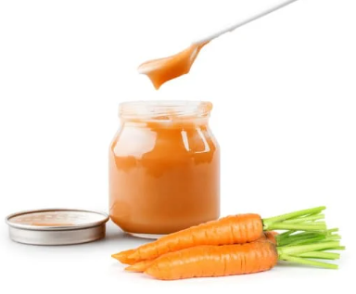
Baby Food
Participants are encouraged to purchase the least expensive brand available.
5
BABY CEREAL ALLOWED:
INFANT FRUITS & VEGETABLES ALLOWED:
INFANT MEATS ALLOWED:
INFANT FORMULA ALLOWED:
8 oz or 16 oz containers of the following brands:
Earth’s Best Organic
Gerber (Original, Organic)
TYPES:
2 oz or 4 oz container single or multipack or 2 packs of 2 oz net wt 4 oz:
2.5 oz containers single or multipack of the following brands:
Beech-Nut
Gerber
TYPES:
Conventional
Beef
Chicken
Turkey
Ham
Brand, type and size listed on benefit.
Conventional or Organic
Jars, \and plastic tubs
Any state of infant fruit or vegetable or blends of fruits and/or vegetables
Textures may range from strained to diced
Package must say “baby”, “infant” or “stage 1” or “stage 2”
BREAST MILK
Complete nutrition for your baby.
Multigrain
Oatmeal
Rice
Whole Wheat
Containers of infant fruit and/or vegetable in the following brands
Beech-Nut (Classics, Naturals, Organic)
Earth's Best Organic
Gerber (Natural, Organic)
Happy Baby Organic
Nature's Promise
O Organics
Parent's Choice
Plum Organics
Tippy Toes (Regular, Organic)
BABY CEREAL NOT ALLOWED:
INFANT FRUITS & VEGETABLES NOT ALLOWED:
INFANT MEATS NOT ALLOWED:
Diced meats or meat sticks
Baby food combinations or dinners (for example, spaghetti and meatballs, or meat and vegetables
Baby cereal with added formula, milk, fruit, or other ingredients
Fruits or vegetables mixed with meat, pasta, rice, cereal, yogurt, spices, or seeds
Fruits or vegetables with Beta Glucan

Slide 6
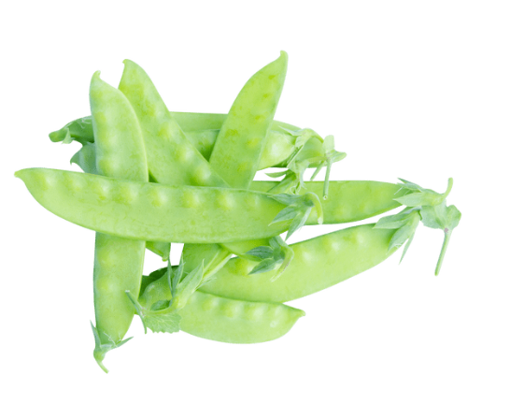
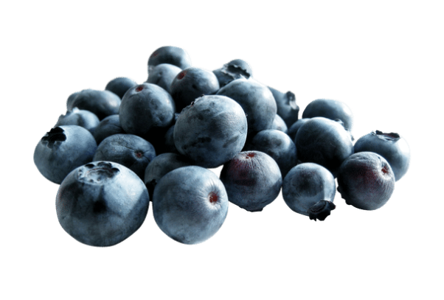
Fruits and Vegetables
Benefit will say “Fruits and Vegetables”
6
Fresh fruits and vegetables benefit can be used with WIC Approved Farmers year-round!
FRESH ALLOWED:
FROZEN ALLOWED:
CANNED ALLOWED:
DRIED ALLOWED:
Any type or variety
Conventional or Organic
Bagged fruits and vegetables
Cut fruit and vegetables (without dip)
Garlic (not on a string)
Herbs cut at the root or root intact
Any package size, brand or mixture
Conventional or Organic
Any package size, brand or mixture
Conventional or Organic
May be in pouches, metal cans, or glass or plastic jars
Fruit must be packed in water or 100% fruit juice, without salt
May contain dried herbs and spices as long as it is not the primary ingredient
Vegetables may have salt, sea salt, reduced salt, no salt or sodium
Any type of dried fruits and/or vegetable
FRESH
NOT ALLOWED:
FROZEN
NOT ALLOWED:
CANNED
NOT ALLOWED:
DRIED
NOT ALLOWED:
Pickled vegetables or olives
Items from the salad bar
Party trays or fruit baskets
Decorative vegetables and painted pumpkins
Herbs must be fresh and not dried
Potted plants
Pie filling
Marinated or in cheese sauce
Home-canned vegetables
Sauces, pasta, spaghetti, or marinara
Cream style corn or olives
Cranberry sauce, soup, ketchup
Fruits or vegetables with added sugars, fats/oils
Fruits in gel, gelatin or syrup
Added sugars, fats/oils, or salt
Loose bulk (self weighed)
Dried option is not available for infants under 1 receiving CVB
Vegetables with added cheese,
sauce, pasta, rice, nuts, breading, or oil
Fruits or vegetables with added sugars or flavoring
French fries, tater tots or twice-baked potatoes
Sorbet or fruit bars
**
.

Slide 7
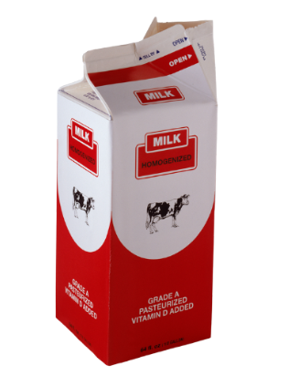
Milk and Plant-Based Beverages
7
MILK ALLOWED:
LACTOSE FREE AND ACIDOPHILUS MILK
ALLOWED (2% ONLY ALLOWED IF ISSUED):
SHELF STABLE MILK
ALLOWED (2% ONLY ALLOWED IF ISSUED):
SOY & PLANT BASED BEVERAGE
ALLOWED IF LISTED ON THE BENEFIT:
Fat content listed on benefit:
1% or skim
2% or 1½%
Whole
Organic milk Quarts, half gallons or gallons
Any mix of allowed container sizes to reach the amount listed on the benefit
Plant-based may be flavored or unflavored
Containers of soy beverage available in the following sizes and brands:
Powdered Nonfat Dry Milk in 3.2 oz,
9.6 oz,, 12.8 oz, 16 oz, 25.6 oz, 32
oz and 64 oz containers and can be purchased with a regular “1% or Skim Milk” benefit. Dry milk does not need to be issued
UHT - Ultra High-Temperature Pasteurized Milk in half gallons or quarts with fat content listed on benefit
Fat content listed on benefit:
1% or skim UHT (can be purchased with a “1% or Skim Milk” benefit)
2% (UHT must appear on benefit)
Whole UHT (can be purchased with a “Whole Milk” benefit)
Lactose Free milk is available in quarts, half gallons or ¾ gallons
Acidophilus milk is available in half gallons and gallons
Fat content listed on benefit:
1% or skim Lactose Free/ Acidophilus milk (can be purchased with a “1% or Skim Milk” benefit)
2% (Only Lactose Free). Lactose Free must appear on benefit
Whole Lactose Free/ Acidophilus milk (can be purchased with a “Whole Milk” benefit)
Silk Aseptic (shelf stable, quart)
Silk Original (half gallon)
Pacific Ultra (shelf stable, quart)
8th Continent
(half gallon)
QUART HALF GALLON
(0.25) gallons (0.50) gallons
ONE GALLON
(1.00) gallons
MILK
NOT ALLOWED:
Pints
Flavored or raw milk
Milk not from cows or goats
Milk in glass bottles
WHOLE GOAT MILK
Whole goat milk may be purchased with a "Whole Milk" benefit
May be powdered or liquid
LACTOSE FREE AND ACIDOPHILUS MILK
NOT ALLOWED:
Pints
BREAST MILK
Complete nutrition for your baby.

Slide 8
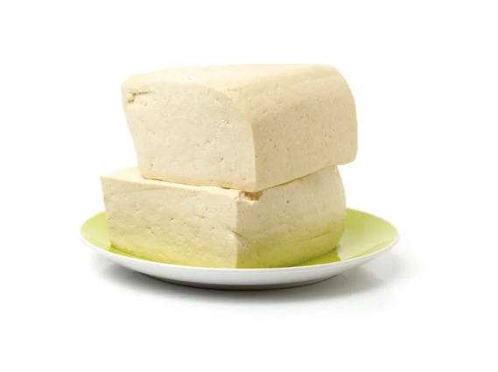
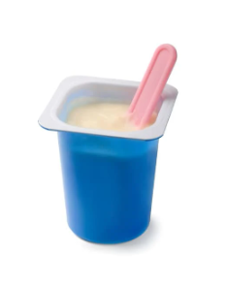
Cheese, Tofu, Yogurt
8
CHEESE ALLOWED:
TOFU ALLOWED:
YOGURT ALLOWED:
8 oz, 12 oz, 16oz, 24 oz, and 32 oz packages
8 oz or 14 to 16 oz packages
8 oz, 16 oz, 24 oz, and 32 oz container or multipack
ALLOWED:
ALLOWED:
Conventional or organic
Cubed, blocks, silken, vacuum packed or sprouted
ALLOWED:
Lactose Free
Fat content listed on benefit
Whole milk yogurt
Low fat or Nonfat Yogurt
Greek or regular
Organic or regular
Plant-based yogurts
Block, shredded, sliced, sticks, strings, crumbles, balls or cubes
Regular, reduced-fat, 2%, or fat-free
Regular or organic
Plant based cheese
The following flavors (may be single flavor or blended):
American
Cheddar
Colby Jack
Monterey Jack
Mozzarella
Muenster
Provolone
Swiss
CHEESE
NOT ALLOWED:
Package sizes other than 8 oz, 12 oz, 16 oz, 24 oz, and 32 oz
Cheese sliced at the deli counter
Dips, whips, spreads, curd cheese or cheese with seasoning
Imported cheese
Sliced cheese labeled “cheese product” or “cheese food”
TOFU
NOT ALLOWED:
YOGURT
NOT ALLOWED:
Package sizes other than 8 oz, 16 oz, 24 oz, and 32 oz
More than 16g of sugar per 1 cup (8 oz)
Drinkable yogurt
Yogurts with mix-in’s
Flavored or baked

Slide 9
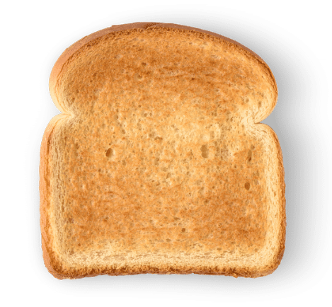
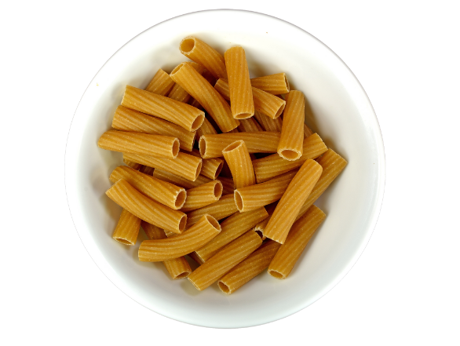
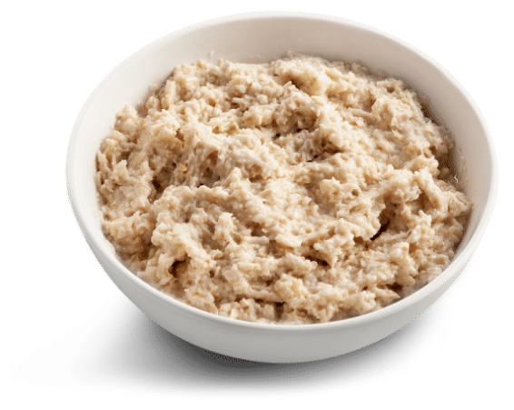
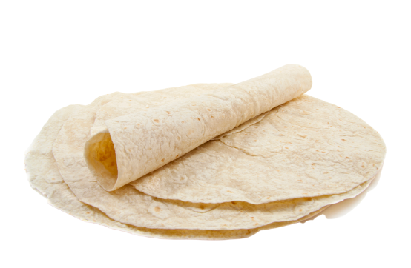
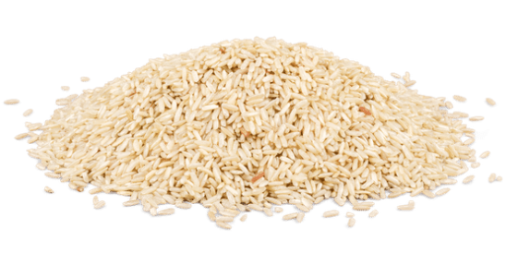
Breads
WHOLE GRAIN ** and WHOLE WHEAT BREAD ALLOWED BREAD SIZES:
12 - 32 OZ BREAD
9
100% Whole Wheat Breads, Buns, or Rolls with “whole wheat flour" and/or "bromated whole wheat flour" as the only flour listed in the ingredients
Whole Grain Breads, Buns, or Rolls with at least 50% whole grains with the remaining grains being either enriched or whole grains
Whole grain pita, English muffin, bagels, naan
If a WIC approved bread is not available when choosing your Whole Grain Item, consider purchasing WIC approved whole wheat pasta, oatmeal, tortillas or brown rice.
24 oz packages for women breastfeeding multiples
12-16 oz packages for all other women and children.
WHOLE GRAIN and WHOLE WHEAT BREAD NOT ALLOWED:
**
For allowable whole grain bread, please use the WICShopper barcode scanner or contact your local agency for an Approved Product List.
Store-made breads Breads with enriched flour as first ingredient
Other Whole Grains
TORTILLAS ** ALLOWED:
OATS & RICE
ALLOWED:
GRAIN OPTIONS ALLOWED:
WHOLE WHEAT PASTA ALLOWED:
8 – 32 oz packages of
whole wheat or soft corn tortillas
Regular or organic brands
Soft corn tortilla made with ground masa flour (corn flour) whole corn, corn (masa), whole ground corn, corn masa flour, masa harina, and white corn flour.
14 – 32 oz packages
Regular or organic
Instant, quick or regular cooking
Oats and rice
14 – 32 oz packages of regular or organic
Instant, quick or regular cooking
Quinoa, bulgur, whole-grain barley, millet, triticale, amaranth, cornmeal, (including blue), corn masa flour, buckwheat, teff, kamut, or sorghum, wheat berries, and other intact whole grains (e.g.,freekeh, spelt, farro, etc.)
12 – 32 oz. packages of any shape 100% whole wheat pasta including organic
OTHER WHOLE GRAINS
NOT ALLOWED:
WHOLE WHEAT PASTA
NOT ALLOWED:
Added fats, sugars, oils or sodium.
Pasta with flours other than “whole wheat flour" and/or "whole durum wheat flour"
GRAIN OPTIONS
NOT ALLOWED:
Added fats, sugars, oils or sodium
Added fats, sugars, oils or sodium
Individual/Single-serve packages
Flavored
Rice that is white or seasoned
Frozen, single-serve, or ready to serve packets

Slide 10
Juice – 64 oz Bottles
11
WIC cannot pay the 5-cent bottle deposit. WIC participants must pay the deposit for each bottle of juice.
100% JUICE ALLOWED 100% JUICE SIZES:
● 64 oz bottles of juice
64 OZ BOTTLES JUICE
64 OZ BOTTLES JUICE (continued)
Hannaford Apple, Cranberry Grape, Grape, Honeycrisp Style Apple, Low Sodium Vegetable, Pineapple, Vegetable, Ruby Red Grapefruit
IGA Apple, Grape, Vegetable, White Grape
Juicy Juice 100% Juice All Flavors
Langers 100% Juice All Flavors except some Plus juices which don't add Vitamin C
Market Basket Apple,880 Cranberry Grape Blend, Cranberry Raspberry Blend, Cranberry Red Delicious Apple Blend, Grape, White Grape, White Grape Peach Blend
Motts Apple Cherry, Apple, Apple Mango, Apple White Grape
Ocean Spray 100% Juice All Flavors
Old Orchard 100% Juice All Flavors
Sesame Street Big Bird Apple, Elmos Fruit Punch
Signature Select Apple, Apple Cider, Cranberry Grape, Cranberry,
Cranberry Raspberry, Grape, Grapefruit, Low Sodium Vegetable, Pineapple, Tomato, Vegetable, White Grape
That’s Smart Grape
Tipton Grove Apple, Cranberry, Grape, Pineapple, White Grape
V8 Low Sodium Vegetable, Original Vegetable, Spicy Hot Vegetable
Welch's Grape (regular, with Calcium, with Fiber), Red Grape,
White Grape, White Grape Peach
Apple And Eve Apple, Cranberry, Cranberry Apple, Cranberry Grape, Cranberry Pomegranate, Natural Apple, Naturally Cranberry, Pineapple Tangerine
Best Yet Apple, Grape, Grapefruit, Pineapple, Tomato, Vegetable, White Grape
Campbells Tomato, Low Sodium Tomato
Food Club Apple, Grape, Tomato, Vegetable, White Grape
Freedoms Choice Apple, Grape
Great Value Apple, Cranberry Grape Blend,
Cranberry Blend, Cranberry Pomegranate, Grape, Guava, Low Sodium Vegetable, Mango Peach, Not From Concentrate Apple, Orange, Pear, Pineapple, Tomato, Vegetable, White Grape, White Grape Peach
•
100% JUICE NOT ALLOWED:
Juice drinks with added sugar
Participants are encouraged to purchase the least expensive brand available.
Juice Cocktails

Slide 11
Cereal (Whole Grain Options)
12
ALLOWED BREAKFAST CEREAL SIZES: 8 OUNCES OR LARGER CONTAINERS
Participants are encouraged to purchase the
least expensive brand available.
Some ways to buy 36 oz of cereal
8
OZ
12
OZ
16
OZ
24
OZ
12
OZ
16
OZ
12
OZ
16
OZ
15
OZ
21
OZ
12
OZ
12
OZ
Cereal selection continued on next page.
WHOLE GRAIN BREAKFAST CEREALS
Best Yet Bite Size Frosted Shredded Wheat, Bran Flakes, Bite Size Strawberry Shredded Wheat, Toasted Oats
Cream Of Wheat Whole Grain Cereal 2 ½ Minutes and Instant**
Food Club Bran Flakes, Toasted Oats
Freedoms Choice Bran Flakes, Frosted Shredded Wheat, Toasted Oats
General Mills Berry Berry Kix, Cheerios (Regular, Oat Crunch Berry, and Vanilla Spice), Fiber One Honey Clusters, Honey Kix, Kix, Multigrain Cheerios, Wheat Chex, Wheaties, Whole Grain Total
Great Value Bran Flakes, Frosted Shredded Wheat, Frosted Mini Wheats Golden Honey, Toasted O's,
Hannaford Bite Size Frosted Shredded Wheat, Wheat, Frosted Shredded Wheat, Multigrain Tasteeos Cereal, Tasteeos, Toasted Wheat, Wheat Flakes, Enriched Wheat Bran
IGA Bite Size Frosted Shredded Wheat and Toasted Oats
Kashi Organic Honey Toasted Hearts and O’s, Organic Warm Cinnamon Hearts and O’s
Kelloggs All Bran Complete Wheat Flakes, Frosted Mini Wheats (Regular, Blueberry, Cinnamon Roll, Little Bites, Pumpkin Spice, Strawberry, Chocolate Little Bites), Special K (Protein, Original, Multigrain, Touch of Cinnamon)
Kiggins Frosted Shredded Wheat (Bite Size)
Malt O Meal Mini Spooners (Frosted, Strawberry Cream), Original Hot Wheat Cereal**
Market Basket Bite Size Shredded Wheat (Blueberry, Frosted, Strawberry), Enriched Bran Flakes, Nutty Nuggets, Oat Squares, Tasteeos, Wheat Biscuits
Post Grape Nuts (Flakes and Original)
Quaker Oatmeal Squares (Brown Sugar, Cinnamon, Honey Nut), Life (Original, Strawberry, Vanilla)
Signature Select Bite Size Frosted Shredded Wheat, Bite Size Shredded Wheat, Bran Flakes, Toasted Oats
** - Serve Hot

Slide 12
Cereal (Non-Whole Grain Options)
12
ALLOWED BREAKFAST CEREAL SIZES: 8 OUNCES OR LARGER CONTAINERS
Participants are encouraged to purchase the
least expensive brand available.
Some ways to buy 36 oz of cereal
8
OZ
12
OZ
16
OZ
24
OZ
12
OZ
16
OZ
12
OZ
16
OZ
15
OZ
21
OZ
12
OZ
12
OZ
Cereal selection continued on next page.
NON-WHOLE GRAIN BREAKFAST CEREALS
Best Yet Corn Flakes, Crispy Rice, Honey Oats And Flakes
Cream Of Rice Cereal and Instant Cereal**
Cream Of Wheat Original Cereal (1 Minute, 2 ½ Minutes, Instant)**
Food Club Corn Flakes, Crisp Rice, Honey And Oats, Honey Oats W/Almonds
Freedoms Choice Corn Flakes (Regular and Honey), Crisp rice, Crispy Honey Oats with Almonds
General Mills Chex (Blueberry, Cinnamon, Corn, Rice)
Great Value Corn Flakes, Corn Squares, Rice Crisps, Rice Squares)
Hannaford Corn Flakes, Crispy Hexagons, Crispy Rice, Oats And More With Almonds, Oats And More With Honey, Toasted Corn, Toasted Rice Cereal
IGA Corn Flakes, Crispy Rice
Kelloggs Corn Flakes (Regular), Crispix, Rice Krispies, Special K Original
Kiggins Corn Flakes, Crispy Rice, Rollin Oats Cereal
Malt O Meal Crispy Rice
Market Basket Corn Biscuits, Corn Flakes, Crispy Hexagons, Crispy Rice, Rice Biscuits
Post Great Grains Banana Nut Crunch, Great Grains Crunchy Pecan, Honey Bunches of Oats Honey Roasted, Honey Bunches Of Oats Maple and Pecans, Honey Bunches Of Oats Vanilla, Honey Bunches of Oats with Almonds
Quaker Original Instant Grits**
Signature Select Corn Flakes, Corn Pockets, Crispy Rice, Oats And More Honey, Oats And More With Almonds, Rice Pockets
That’s Smart Crisp Rice
** - Serve Hot

Slide 13
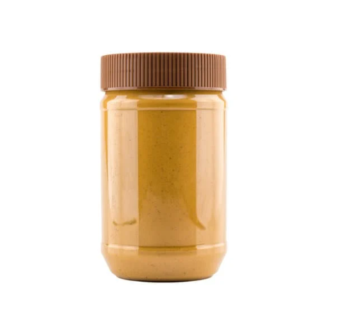
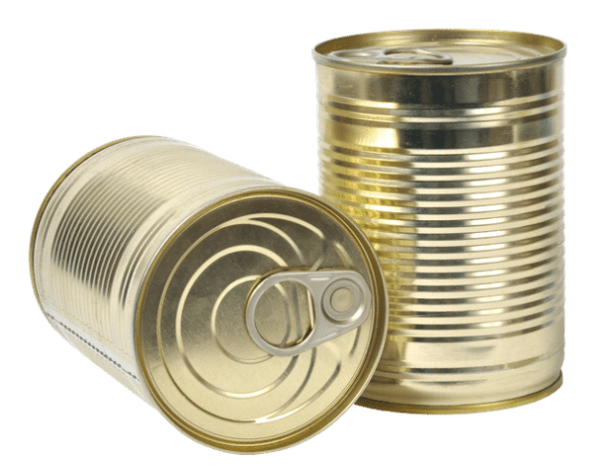
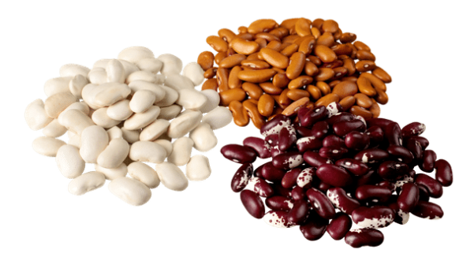
Nut and Seed Butters, Beans, Peas and Lentils
14
DRIED BEAN, PEAS, LENTILS ALLOWED:
CANNED BEANS
ALLOWED:
NUT AND SEED BUTTER ALLOWED:
16 and 32 oz packages
Any type of unflavored dried beans/peas/lentils.
Regular or organic
14 to 16 oz cans only
Plain canned beans, including fat-free refried beans, regular or organic, low sodium or no salt added
16 to 18 oz containers
Smooth, creamy, chunky or crunchy
Regular or organic
DRIED BEANS, PEAS, LENTILS
NOT ALLOWED:
CANNED BEANS
NOT ALLOWED:
PEANUT BUTTER
NOT ALLOWED:
Beans with added sugars, fats, oils, meats, fruits or vegetables
Soup mixes or dried beans/peas/lentils with flavor packets
Green or wax beans or green peas – you can buy these with a fruit and vegetable benefit
Baked beans, pork and beans, or soup mix
Beans with added sugars, fats, oils, meats, fruit or vegetables
Peanut butter with added sweeteners or flavors such as honey, marshmallow, jelly, or chocolate
Packets or squeezable containers
Peanut butter spreads

Slide 14
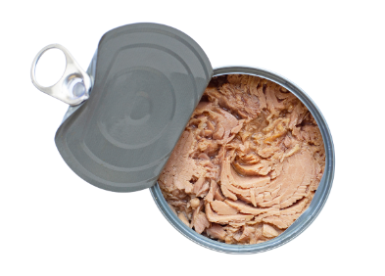
Eggs and Canned Fish
15
EGGS ALLOWED:
CANNED FISH ALLOWED:
A full dozen of any size
Brown or white shells
Regular or organic
Cage-free
Free-range or free-running
3.75 to 15oz containers of chunk light tuna, pink salmon or sardines
Pouches or cans (including multipacks)
May contain vegetable broth
Regular, low sodium or no salt added
May be packed in water or oil
May include bones or skin
Seasoning including lemon or herbs
EGGS
NOT ALLOWED:
CANNED FISH
NOT ALLOWED:
Sizes other than one dozen
Low cholesterol
Albacore, solid white or yellow fin tuna
Smoked fish
Kippered fish

Slide 15
Frequently Asked Questions
16
If I am eligible for WIC, how long can I get benefits?
While pregnant
Up to one year after delivery if you are breastfeeding your baby
Up to six months after delivery if you are not breastfeeding
Up to a child’s fifth birthday
Why can’t WIC staff talk to family members or my friends about my child or me?
The WIC program protects your right to privacy. WIC will not share any information without your permission. This includes appointment times and medical information. However, if a WIC staff member believes that a child is in danger, she or he is required by law to report this to a DHHS staff member who will follow up with the family.
What if I move?
If you plan to move somewhere else in Maine, you can check our website for a listing of all WIC offices in the state at www.maine.gov/WIC. If you plan
to move out of Maine, please let WIC staff know.
What if I lose my eWIC card or it is stolen or damaged?
Notify your WIC office right away. Treat your eWIC card like cash. Keep it in a
safe place.
What is an Alternate Representative / proxy?
A proxy is someone you trust. You give this person permission to use your eWIC card at the grocery store or to attend WIC appointments for you.
If you assign someone to be a proxy, that person must:
Understand what foods to buy and how to use the eWIC card
Bring a form of identification to WIC appointments
Do I need to purchase everything listed on my eWIC benefit?
No, you are not required to pick up everything in one trip. Unused benefits
do not carry forward.
What if I have spent all of my eWIC benefit and my baby is out of formula? WIC can only provide a certain amount of formula each month. As your baby gets older, he or she may need more formula than you receive from WIC. If this happens, you will have to buy the extra formula until your next eWIC benefit begins.
Can I participate in more than one WIC program at the same time?
No.
FREQUENTLY ASKED QUESTIONS

Slide 16
What to bring to your WIC appointment
17
Proof of identification for yourself and each person who is applying for WIC (examples):
Military, photo, passport or school ID
Driver’s license
Birth certificate
MaineCare card (or paperwork)
Shot/immunization records
Foster care/adoption paperwork
Social Security card
Proof of residency (examples):
Envelope that was mailed to your home address
Utility bill
Rent receipts
Official letter
Driver’s license with your home address
Proof of household income for all people living in your house (examples):
Paycheck stubs for current job
Tax return for previous year (only if current income is the same)
Eligibility paperwork for MaineCare, TANF or SNAP
FREQUENTLY ASKED QUESTIONS

Slide 17
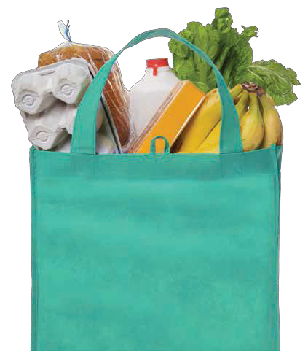
Shopping Hints
18
BEFORE YOU SHOP:
Make sure you have your eWIC Card with valid benefits loaded.
WHILE SHOPPING:
Use your benefits as your shopping list.
Use this booklet or the WICShopper App to help you select WIC approved foods that match your benefit.
Refer to your benefit for the amounts (1 Container) and size (64 Ounces) of the foods you can buy.
Your benefit balance on the WICShopper app will update regularly throughout the day.
BEFORE CHECKOUT :
Check with the store before using the self checkout lane.
AT THE REGISTER:
If you are purchasing more than 50 WIC approved foods, your purchase will need to be split into 2 transactions.
Use your eWIC card as your first payment type. If you are buying non-WIC approved foods, you can use another method of payment after using your eWIC card.
Be sure to review your WIC purchase before approving the transaction.
If your card is denied for Insufficient Funds, check store printed Balance Inquiry Receipt for the quantity/unit of measure match to WIC food selected.
Keep your eWIC card so that future benefits may be loaded.
WIC does not pay for bottle deposit & bag fees.
Get your receipt and eWIC card before leaving.
SHOPPING HINTS

